Slide 1




Crypto Scanner
Witold Zolnowski

Slide 2
Outline
What?
Why?
How?!

Slide 3
Cryptocurrencies and why should you care!

Slide 4
Cryptocurrency
&
Arbitrage
Why cryptocurrency markets?
‘Wild west’ of investing
Very volatile
Relatively inefficient
Opportunities for arbitrage & automated trading

Slide 5
Crypto markets
Overview of crypto space
1600 crypto currencies
Over 11000 markets
Total market cap of over $250 billion

Slide 6
Arbitrage
Arbitrage between markets
Buy at Market 1 for $1
Sell at Market 2 for $1.01
Quick turnover
Small PROFIT at MINIMAL risk

Slide 7
Problem
Why you can’t do it manually:
Too many currencies traded at too many markets
In order to be competitive, automated trading at razor thin margins is a must

Slide 8
Solution through automation

Slide 9
Crypto Scanner
Desktop application
Able to scan hundreds of currencies listed at dozens of markets
It will store data for future, long term analysis
Eventually, it will be able to take action on identified opportunities

Slide 10
Requirements
Request data from multiple markets simultaneously
Analyse data, and display results
Update data in a real time
Save data to database
Run scheduled scan
Email scan results

Slide 11
System
Cross-platform ( Electron )
Node.js
MongoDB

Slide 12
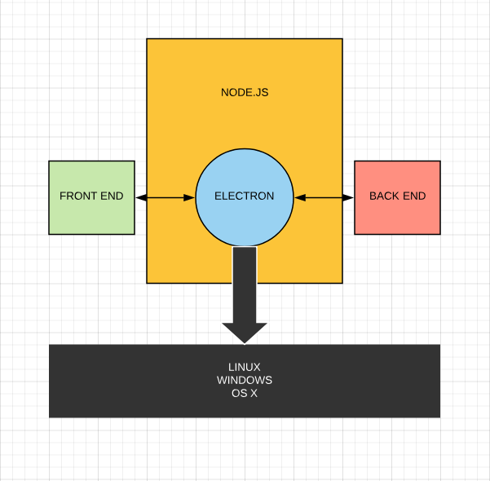
System diagram

Slide 13
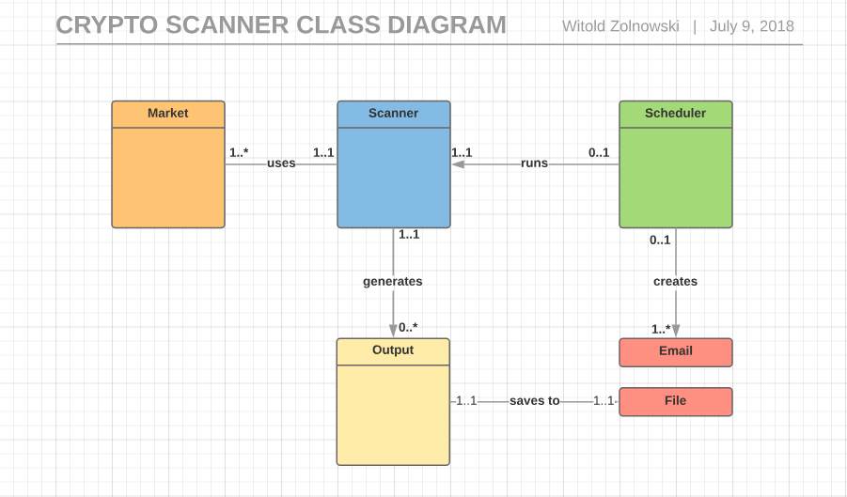

Slide 14
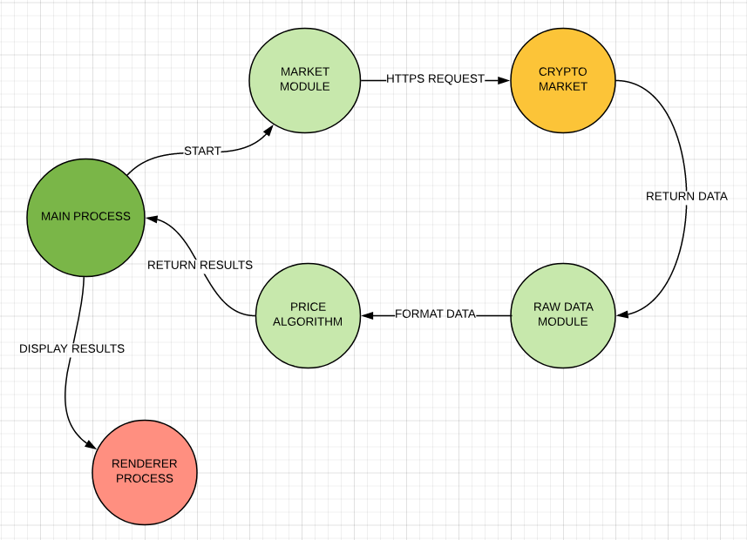
PROCESS FLOW

Slide 15
Wireframes

Slide 16
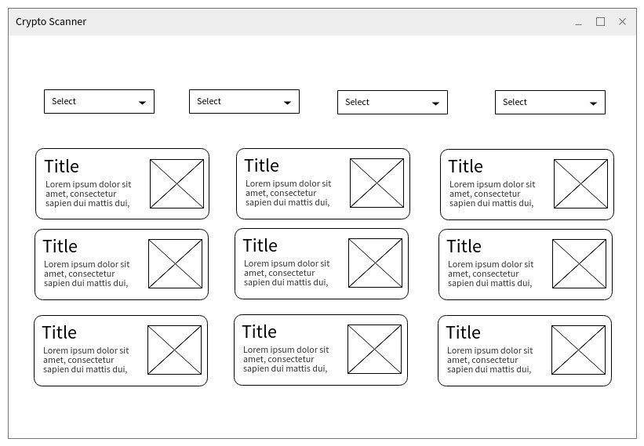
Results & Options

Slide 17
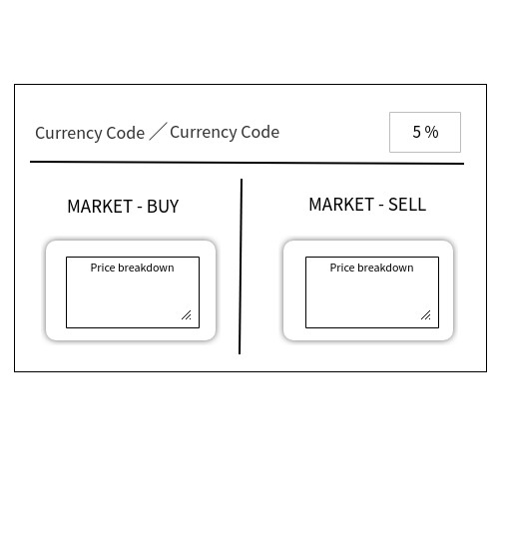
Individual result element

Slide 18
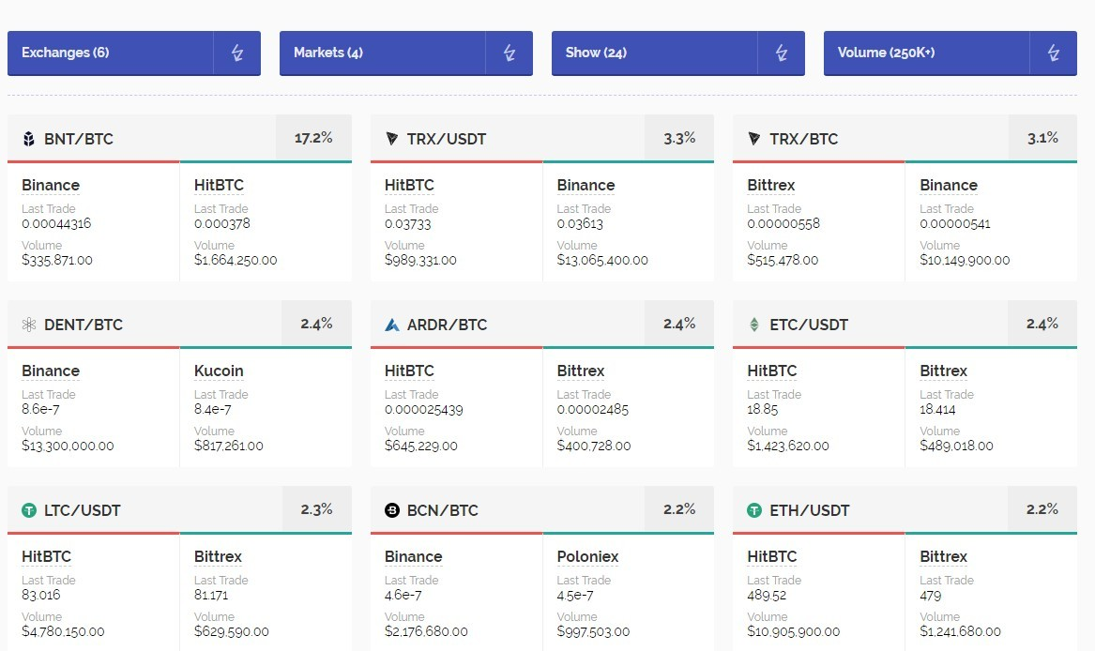
Results page draft

Slide 19
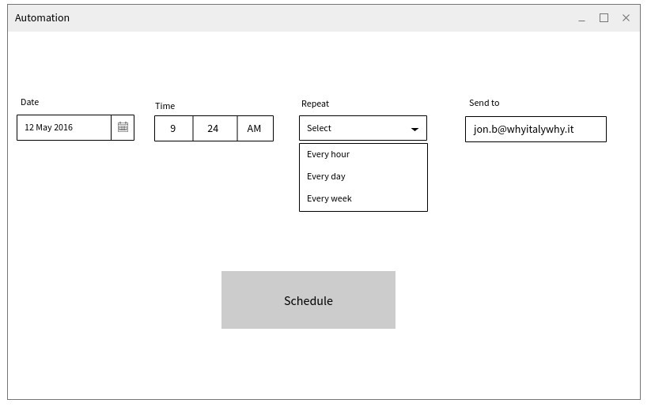
Scheduler & Emailer

Slide 20
Timeline
MAY
JUN
JUL
AUG
Documentation
Market Modules
Price Algorithm
Front End

Slide 21
Questions?

Slide 22
References
Wireframes -- https://wireframepro.mockflow.com
UML charts -- https://www.lucidcharts.com

